Slide 1
Colors
Taught by Yossef Ayman Zedan

Slide 2
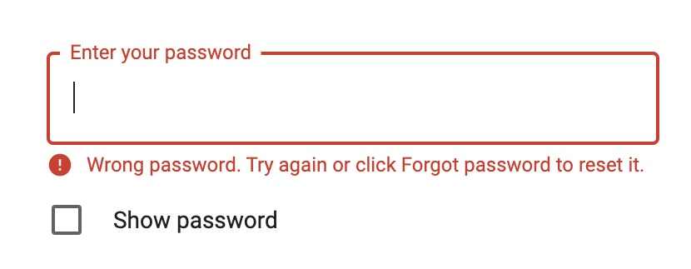
Danger and Success colors
Every color has its own meaning. For example, we can use danger color to show that there is an error as the image mentioned below

Slide 3
Danger and Success colors
Success color can be used as the opposite purpose of the danger, which is there is no error and everything is working good.

Slide 4
Secondary Color
Secondary color can be used as a note on the web page with a smaller font size as mentioned in the image below

Slide 5
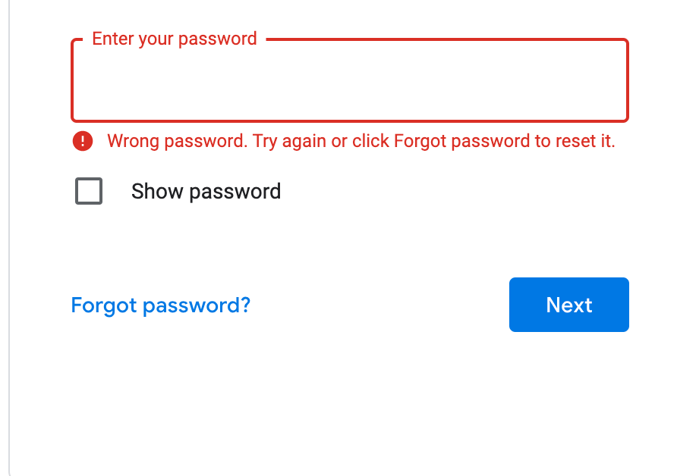
Primary color
Primary color can be used for the buttons of sign in and sign out for an example

Slide 6
Warning color
Warning color can be used as an alert on the screen to warn the user that something may happen. For example, your login session will end up in 5 minutes, save your work better now

Slide 7
Info
There is no certain purpose for the info.. It can be used for dark themes as an alert

Slide 8
Light and dark Colors
Light color can be used for dark backgrounds and dark themes
Dark color can be used as a color instead of the basic black color. For example, <body class=“text-dark”>
This body has the dark color customized by bootstrap
</body>

